Slide 1


Cloud Native Workshop Inventory Backend-for-Frontend
IBM Hybrid Cloud Ecosystem
Ecosystem Labs

Slide 2
Objective
Develop and deploy the orchestration layer between the core business services and the specific digital channel (User Interface)
Outcome
Fetch the list of stock items from the backend API
Expose stock items using GraphQL and REST frameworks
Approach
Test Driven Development
Backend-for-Frontend architecture component
Technical implementation
TypeScript-based REST endpoint controller

Slide 3
The General-Purpose API Backend
Single server-side API accommodating more than one type of UI and different processes
Easy to be successful when different UIs want to make the same or very similar sorts of calls
However, user experience often differs drastically from one UI to another
Providing functionality to multiple user-facing applications, a single API backend can become a bottleneck when rolling out new delivery

Slide 4
Backend-for-Frontend (BFF) pattern
Backend For Frontend overcomes this problem by having separate BFF for each UI component.
The BFF is tightly coupled to a specific user experience and will typically be maintained by the same team as the user interface.
Makes it easier to define and adapt the API as the UI requires. That allows it to be focused and will therefore be smaller.
Simplifies the process of lining up release of both the client and server components.
Inventory BFF acts as an orchestrator between the core business services and User Interface(s).

Slide 5
Applying BFF
When to use
The user interface connects with multiple backend services
Data and protocol transformation is required (e.g. remove unnecessary data elements, restructure data to match front end components, translate HTTP to Kafka)
Optimize the backend for the requirements of specific client interfaces
A shared or general-purpose backend service must be maintained with significant development overhead
Concerns
If different interfaces (such as mobile clients) will make the same requests, consider whether it is necessary to implement a backend for each interface, or if a single backend will sufficient
BFF should contain presentation logic, not business logic
Code duplication across services is highly likely when implementing this pattern
Think about how this pattern might be reflected in the responsibilities of a development team

Slide 6
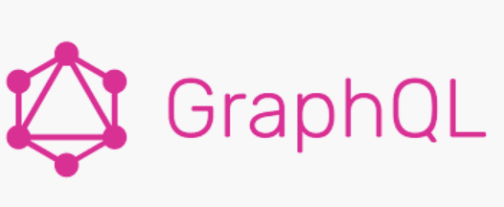
GraphQL
GraphQL is a query language for APIs and a runtime for fulfilling those queries with your existing data. API, gives clients the power to ask for exactly what they need and nothing more.
On-demand model definition
Get many resources in a single request
Receive notifications of changes to the data
Evolve your API without versioning

Slide 7
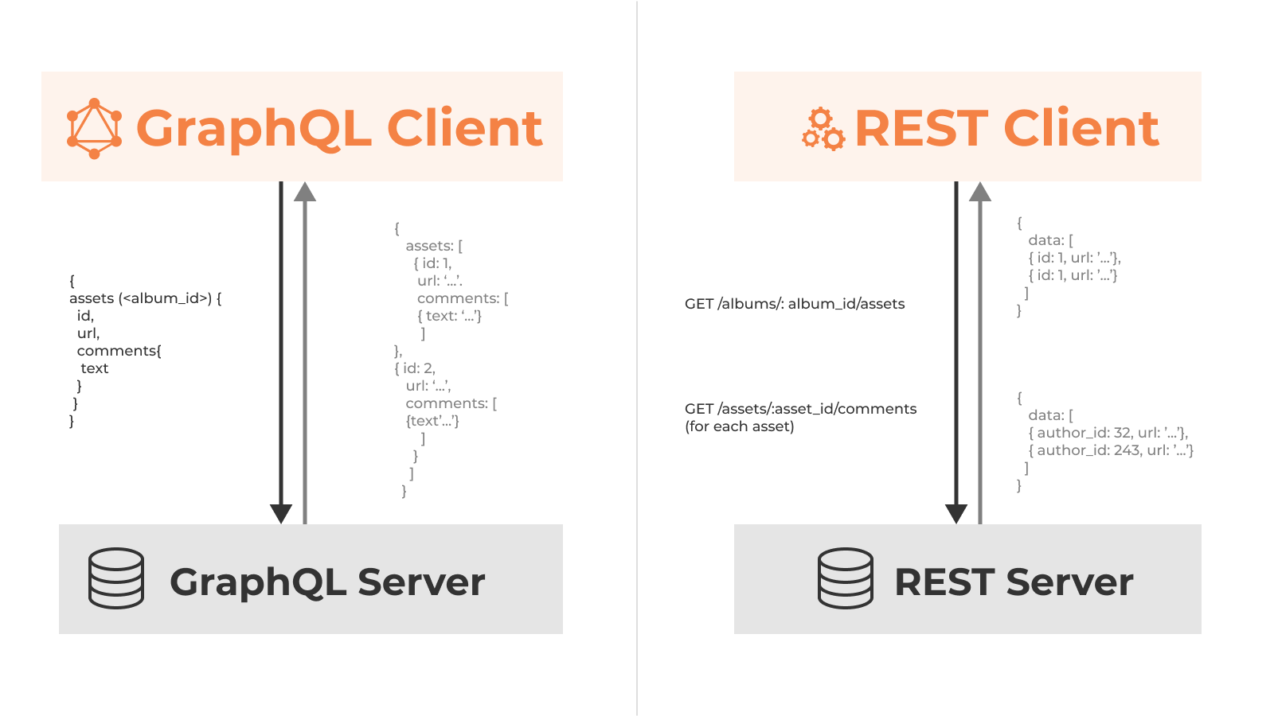
GraphQL vs REST
REST lacks scalability and GraphQL can be accessed on demand. The payload can be extended when the GraphQL API is called.
REST’s operation for each resource is an endpoint, and GraphQL only needs a single endpoint, but the post body is not the same.
REST requires multiple calls for nested complex data, GraphQL calls once, reducing network overhead.
REST can accurately return HTTP error code, GraphQL returns 200 uniformly, and wraps error information.

